Slide 1
Predicting housing prices for kaggle
Brandt Germann

Slide 2
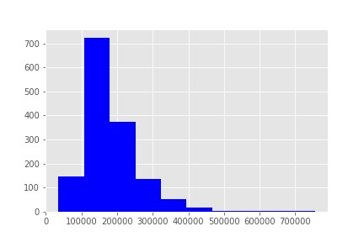
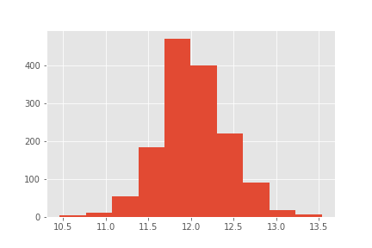
Converting Target – Right skew
Using log of SalePrice to normalize

Slide 3
Starting point - Corr of numerical features
SalePrice 1.000000
log_SalePrice 0.948374
OverallQual 0.790982
GrLivArea 0.708624
GarageCars 0.640409
GarageArea 0.623431
TotalBsmtSF 0.613581
1stFlrSF 0.605852
FullBath 0.560664
TotRmsAbvGrd 0.533723
YearBuilt 0.522897
YearRemodAdd 0.507101
GarageYrBlt 0.486362
MasVnrArea 0.477493
Fireplaces 0.466929
BsmtFinSF1 0.386420
LotFrontage 0.351799
WoodDeckSF 0.324413
2ndFlrSF 0.319334
OpenPorchSF 0.315856
HalfBath 0.284108
LotArea 0.263843
BsmtFullBath 0.227122
BsmtUnfSF 0.214479
BedroomAbvGr 0.168213
ScreenPorch 0.111447
PoolArea 0.092404
MoSold 0.046432
3SsnPorch 0.044584
BsmtFinSF2 -0.011378
BsmtHalfBath -0.016844
MiscVal -0.021190
Id -0.021917
LowQualFinSF -0.025606
YrSold -0.028923
OverallCond -0.077856
MSSubClass -0.084284
EnclosedPorch -0.128578
KitchenAbvGr -0.135907

Slide 4
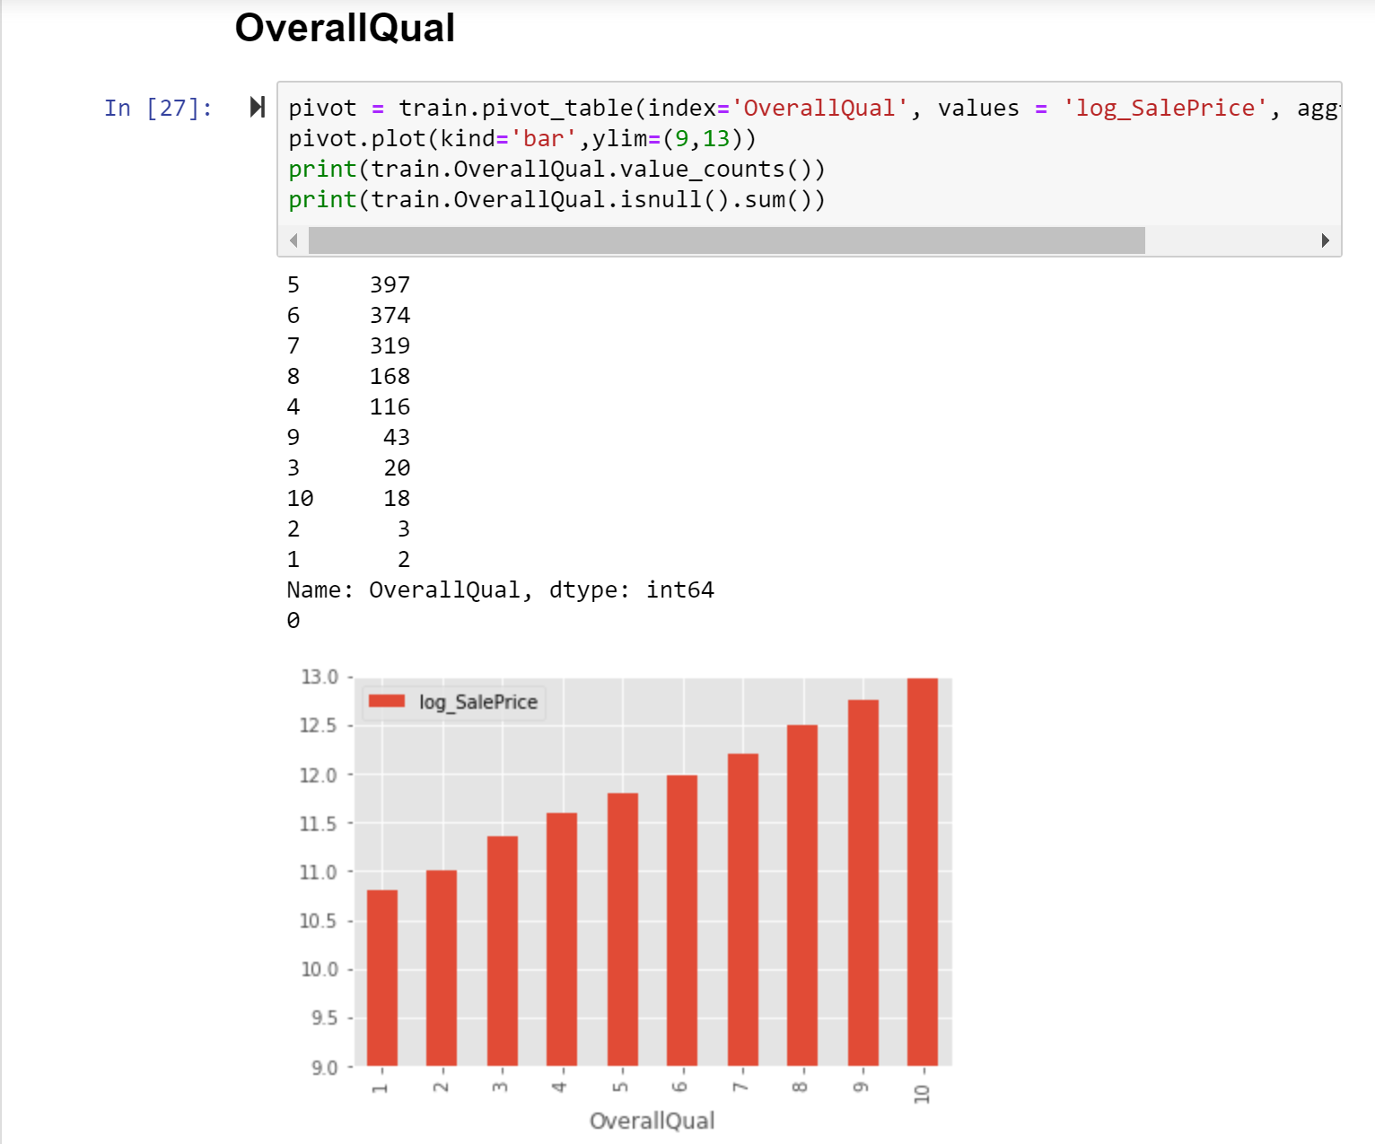
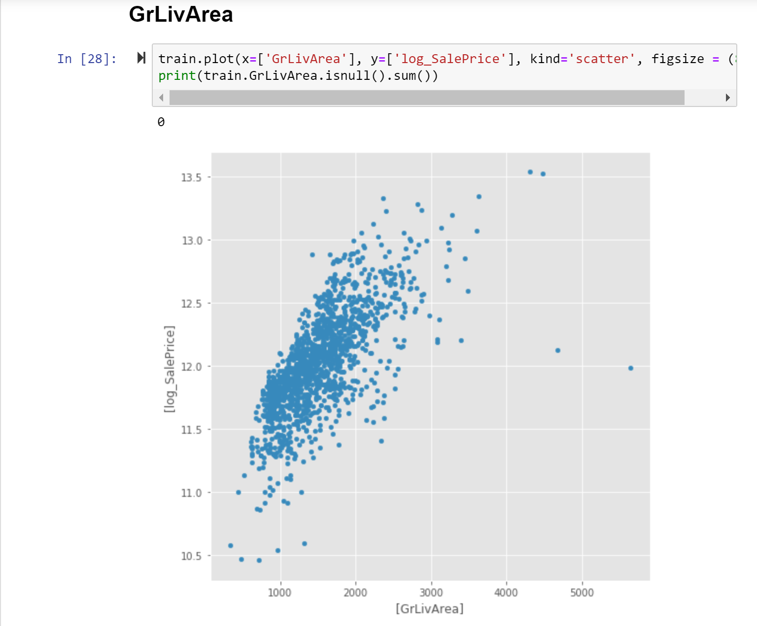
RDA: Checking for null/outliers for all numerical columns

Slide 5
Feature engineering
Reviewed features 1-by-1, with data description
Removed 7 outliers
Combined features (ie. HalfBath + FullBath, SF)
Reclassified several features from numerical to categorical (GarageCars, YrSold, OverallQual)
Removed features with severely imbalanced value counts
Removed additional low corr, problematic or clearly redundant features (ScreenPorch, PoolArea, MiscVal..etc)
Changed Garage/ NA to ‘None’
Sqrt of area features (SF)

Slide 6
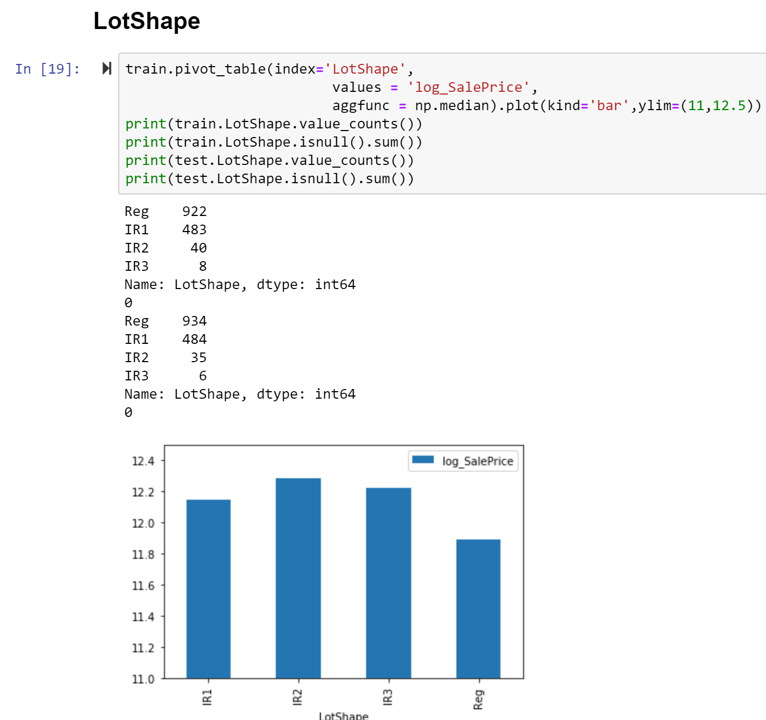
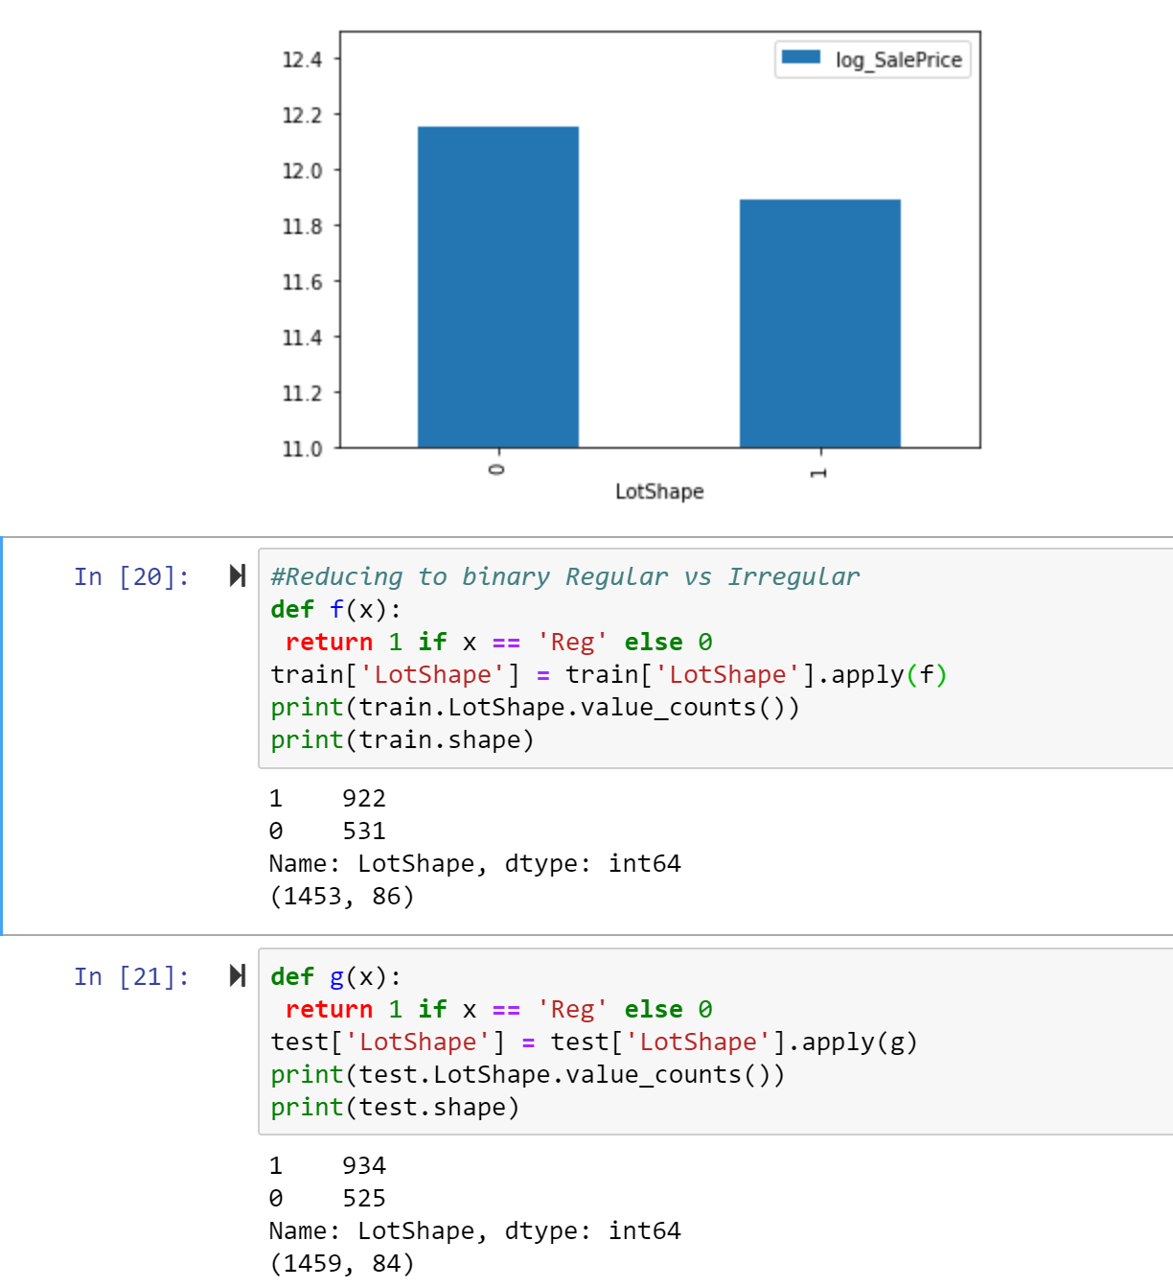
Categorical features – Inspecting train/test for null vals & counts

Slide 7
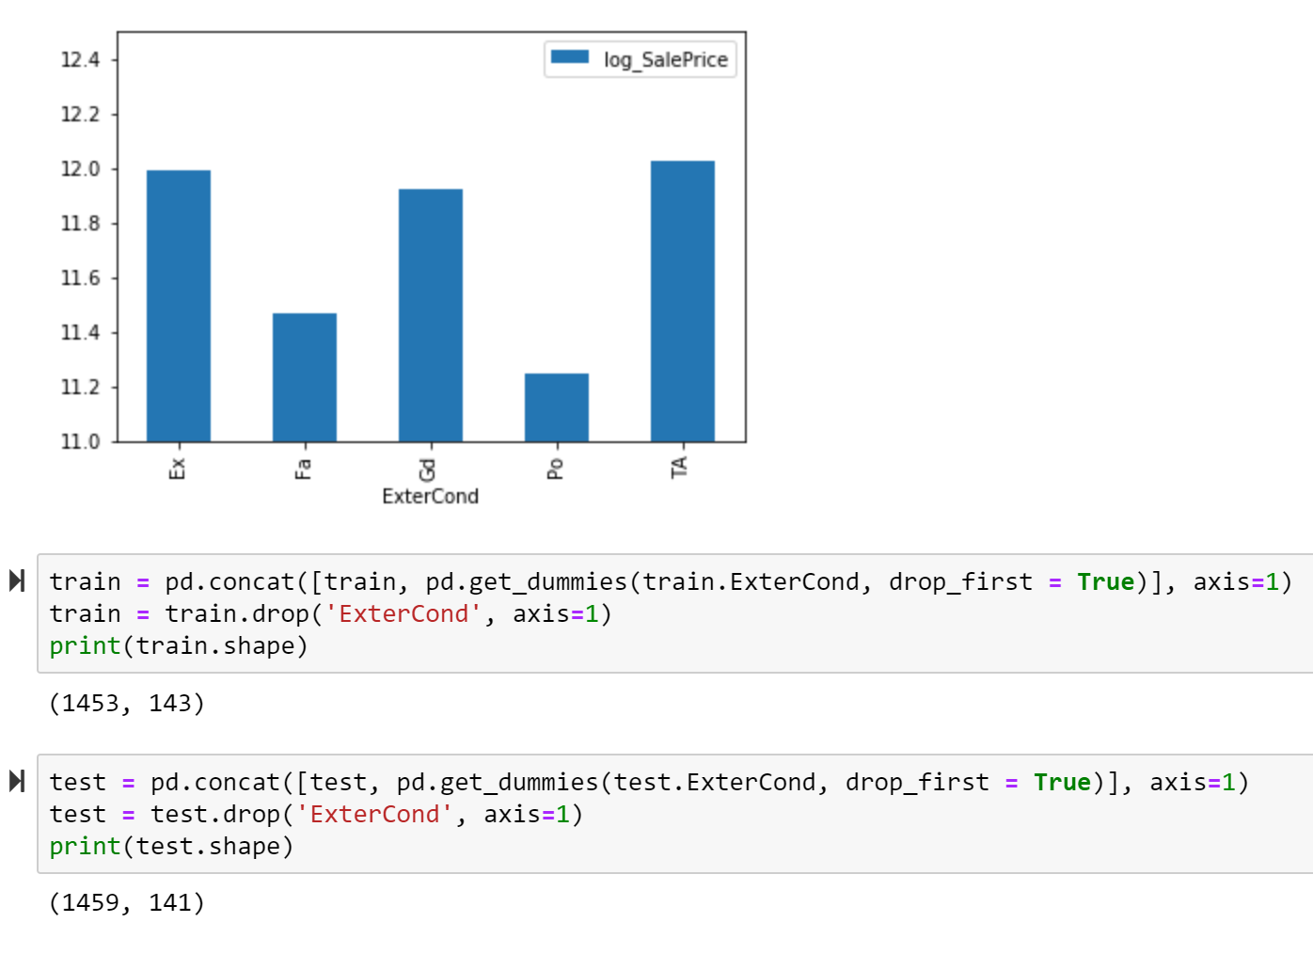
Categorical features – dummifying
Dummified remaining categorical features
Reduced classifications where possible
Resulted in 211 features
**sanity checks as I progressed

Slide 8


Models/methods
results
Train_test_split
10Fold Cross Validation
Linear Regression (.01335)
Ridge (.13299, alpha = .1)
Lasso (.02339)
Elastic Net
Ridge provided best test values
R^2 Train: .9510
R^2 Test: .9110

Slide 9
Lessons learned / future considerations
Test models more often during feature selection / engineering
ID issue with my Lasso model
Reclassify additional categorical features
Incorporate tree based models
Map locations to consolidate Neighborhoods

